Slide 1

Module 1: Current Computer Security Landscape
Prepared By:
Prof. Sridhar C Iyer
Assistant Professor
Dept. of Computer Engineering
Dwarkadas J Sanghvi College of Engineering

Slide 2

Introduction
Importance of Cybersecurity
Discusses the critical role that cybersecurity plays in safeguarding computer systems, networks, and data from various threats, emphasizing its significance in the modern digital landscape.
Significance of computer and network security in the digital age.
As digital technology becomes increasingly integrated into everyday life, ensuring the security of computer systems and networks becomes more crucial than ever.

Slide 3

Growing Threats
Escalating volume and sophistication of cyber threats.
Indicates that the number of cyber threats is not only increasing but also becoming more sophisticated, posing greater challenges to security professionals.
Targets: individuals, organizations, and governments.
Identifies that cyber threats are not limited to specific entities; individuals, organizations, and even governments are susceptible to various forms of cyber attacks.

Slide 4

Evolution of Cybersecurity
Emergence of cybersecurity specialists.
Role: Protecting systems from diverse threats.

Slide 5
Changing Landscape
Impact of computerization, digitization, and Internet interconnection.
Evolution in security mechanisms and defense strategies.

Slide 6
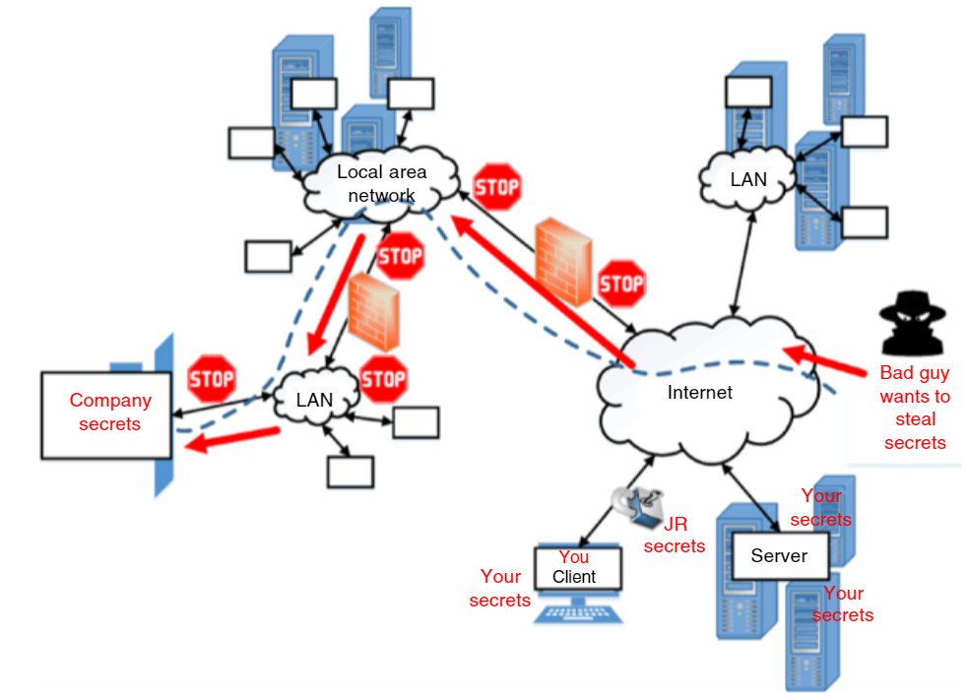
The proliferation of Internet-connected devices in recent decades has surged.
Modern products are designed with high-speed Internet capabilities, generating massive amounts of data that require efficient handling.
Despite the benefits, the evolving landscape has also given rise to more intricate cyber exploits, emphasizing the critical need for robust security measures.

Slide 7
Challenges in Modern Technology
Increasing number of Internet-connected devices.
Complexity of cyber threats.

Slide 8
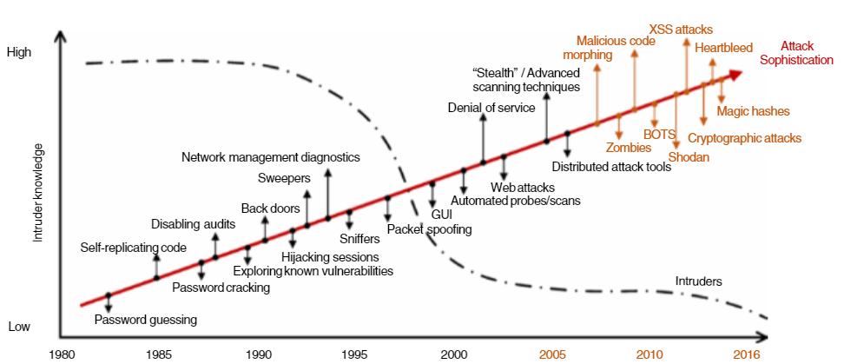

Slide 9
Heartbleed Bug
The Heartbleed Bug is a serious vulnerability in the popular OpenSSL cryptographic software library. This weakness allows stealing the information protected, under normal conditions, by the SSL/TLS encryption used to secure the Internet. SSL/TLS provides communication security and privacy over the Internet for applications such as web, email, instant messaging (IM) and some virtual private networks (VPNs).

Slide 10
Reasons for Growing Cybercrime
Quick adoption of new technologies.
Increased online users from low-income communities.
Financial sophistication of cybercriminals.

Slide 11

Government Initiatives
Enhancing resilience against automated, distributed threats.
Collaborative efforts with international partners.

Slide 12
Some Statistics
Just some recent data. M‐trends (2020) reports that in 2019, Mandiant professionals observed that attacks:
7% originated with or used compromised third‐party access,
15% had multiple attackers,
less than 1% involved an insider,
22% had data theft likely in support of intellectual property or espionage end goals,
29% were likely for direct financial gain including extortion, ransom, card theft, and illicit transfers,
3% of these targeted attacks were for the purpose of reselling access gained in the intrusion,
4% likely served no purpose except for creating compromised architecture to further other attacks.

Slide 13
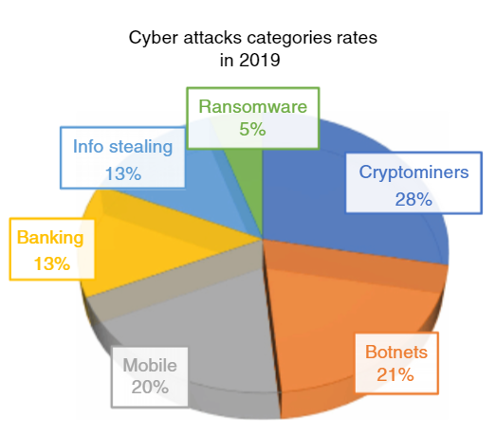

Slide 14
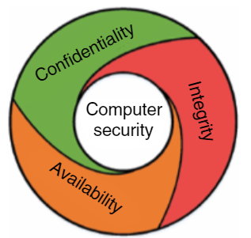
Computer Security Basics
Fundamental Concepts: Confidentiality, Integrity, Availability (CIA).
Protection goals against cyber attacks.

Slide 15
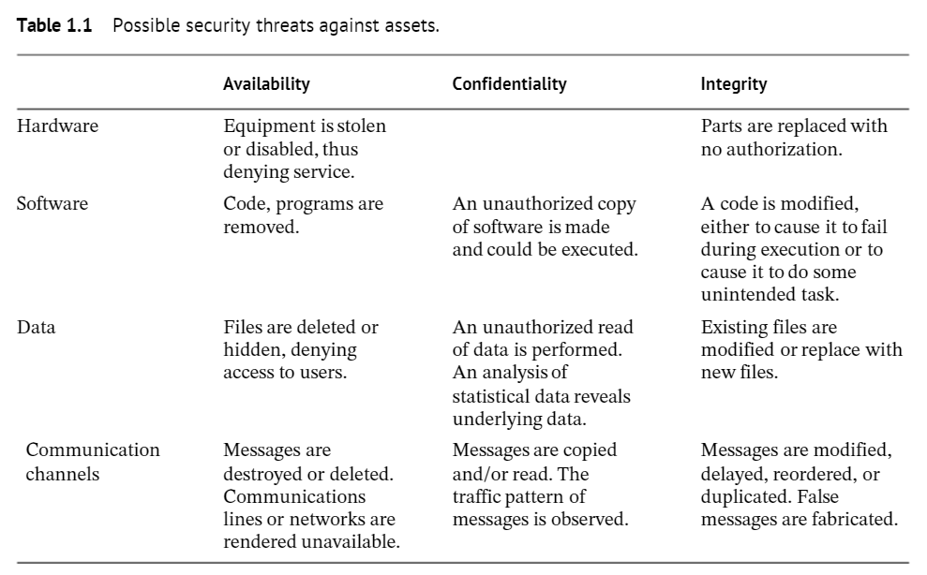

Slide 16
Attack in Computer Security
Definition of an attack in computer security.
Defensive goals to protect against attacks.

Slide 17
Sources of Security Threats
Weaknesses in infrastructure and protocols.
Design and implementation issues.
Vulnerabilities in software.
Hacker activities and social engineering.

Slide 18
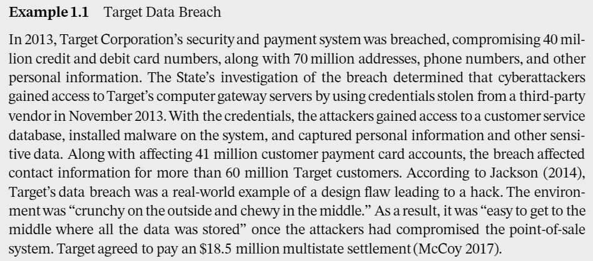
Some Case Studies

Slide 19
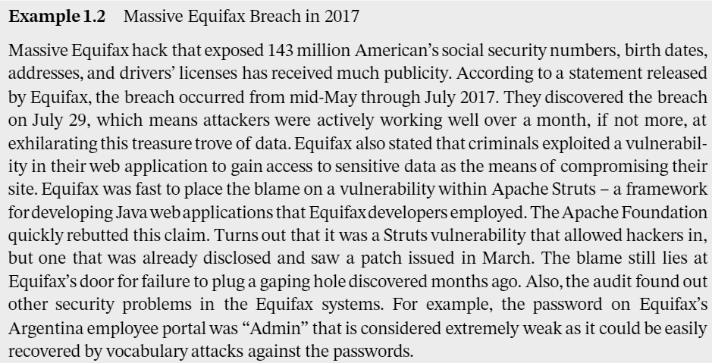
Some Case Studies

Slide 20
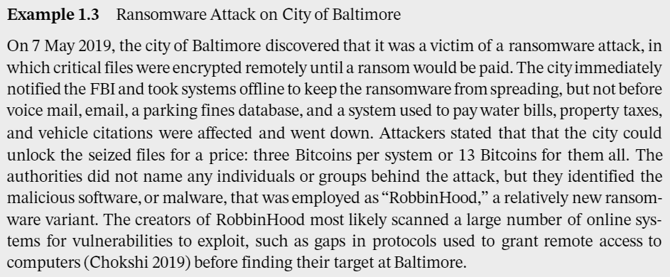
Some Case Studies

Slide 21
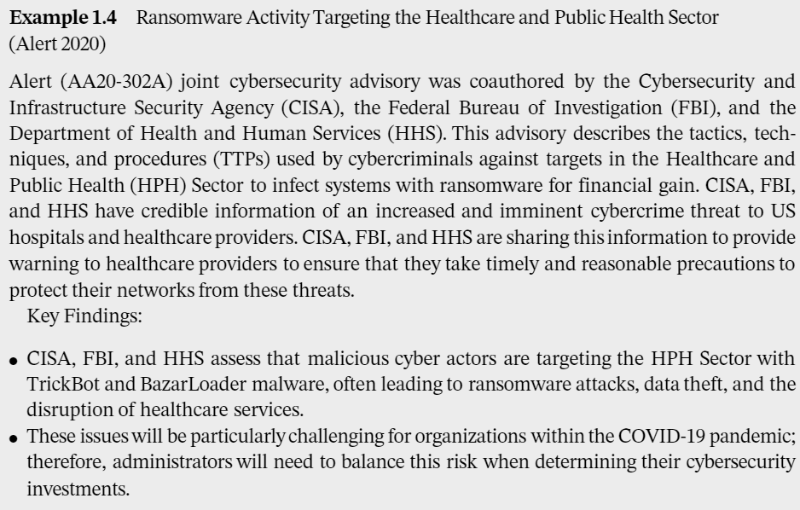
Some Case Studies

